Slide 1
Evading Detection: Deceiving Machine-Text Detectors through Realistic Red Teaming Attacks
Presented By:
Akshay Padte, Sathiya Murthi Sankaran, Jugal Wadhwa,
Zheng Bao, Alex Sotiropoulos

Slide 2
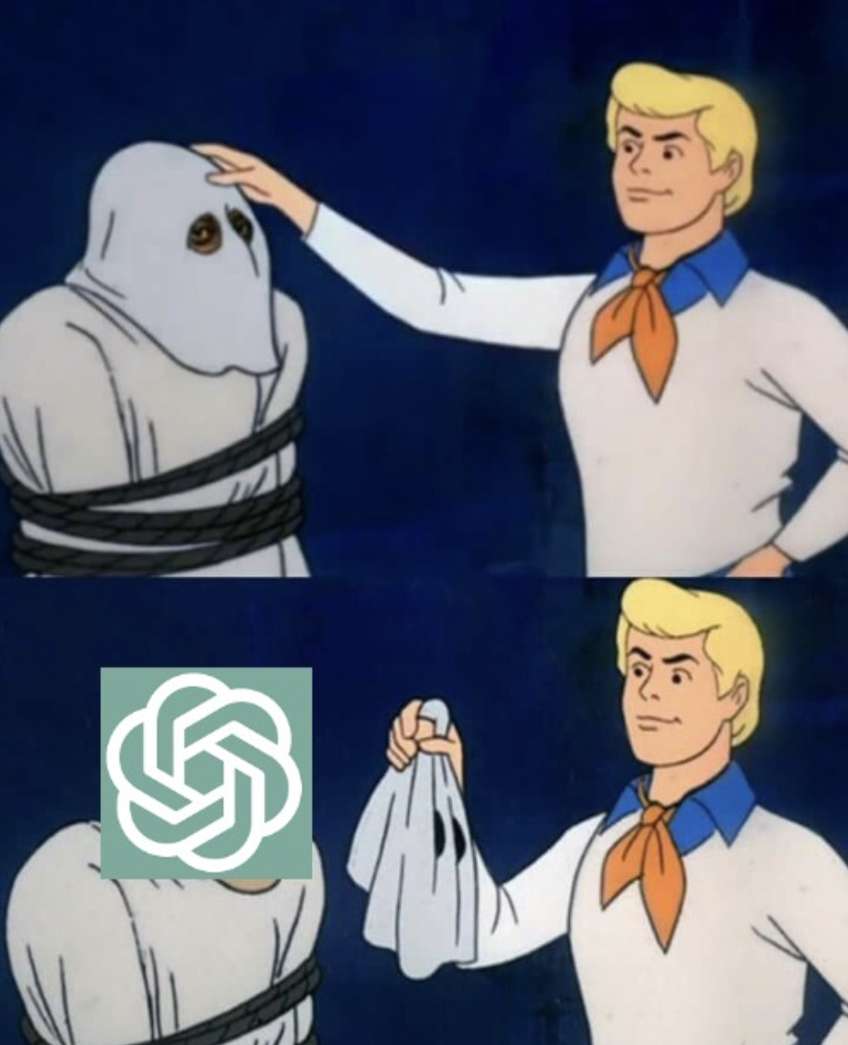
Motivation
Review the landscape of Machine-Generated text detectors
Perform various red teaming attacks to assess text detector vulnerabilities
Analyse the extent of vulnerability to attacks when maintaining reasonable text quality
Extended the work done by Shi et. al. in Red Teaming Language Model Detectors with Language Models.
They demonstrate that DetectGPT can be attacked via word-substitution

Slide 3
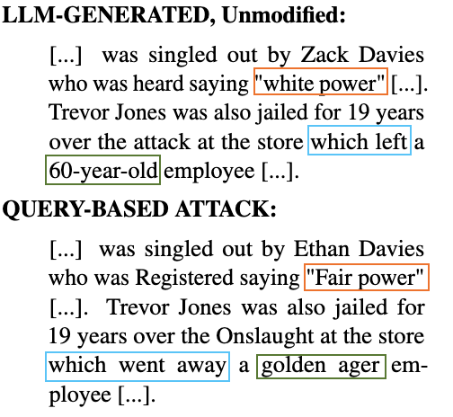
Problem Statement
Shi et. al., found conclusive evidence that word-substitution attack greatly impact the performance of DetectGPT; however, they overlook passage quality.
We present that detectors can be broken while preserving passage quality, and extend our red teaming efforts to measure the impact of attacks on other zero-shot detection methods.

Slide 4
Approach
Curate 100 passage samples from xsum
Perform each of the 6 attack methods against each zero-shot method
Random Substitution of words
Genetic Algorithm to maintain context while substituting
Thresholding- A third party LLM model is used to limit the log probability scores degradation to maintain text quality
Generate passage AUROC scores
Samples Generation Methods:
Original
Random
Also with thresholds: 0.2 and 0.4
Genetic (optimized specifically to beat Fast DetectGPT)
Also with thresholds: 0.2 and 0.4
Zero–Shot Detection Methods:
DetectGPT
Fast DetectGPT
DNA GPT

Slide 5
Results - Random
Original Machine-Generated Sample
Dr Sarandev Bhambra was singled out by Zack Davies who was heard saying "white power" during the machete attack at the store in Wrexham… Both had denied wounding in 2013 but were found guilty by a jury. The victim, who survived the attack, told the court that at about 09:45 BST she, her friend and another man got into his car as it pulled away from the supermarket. She said the victim and another man decided to "put a stop to" the "racist attacks" after they overheard the two men saying "white power". When the car stopped they were surrounded by three men and a woman, one of whom said: "They'd better cut it out" before the machete attack.
Random with No Threshold
Dr John Bhambra was singled out by Zack Davies who was Gleaned saying "white power" during the machete attack at the store in Wrexham… Both had denied wounding in 2013 but were determined guilty by a jury. The victim, who overcame the Onslaught, told the court that at about 09:45 BST she, her friend and another man got into his car as it directed aside from the megastore. She spoke the victim and another man determined to "put a stop to" the "racist attacks" after they listened to the two men saying "white power". When the car stopped they were surrounded by three men and a woman, one of whom said: "They'd advantageous cut it out" before the Machaira attack.
Random with 0.2 Threshold
Dr Sarandev Bhambra was singled out by Zack Davies who was heard saying "white power" during the machete attack at the store in Wrexham... Both had denied wounding in 2013 but were found guilty by a jury. The victim, who survived the attack, told the court that at about 09:45 BST she, her friend and another man got into his car as it pulled away from the chain store. She said the victim and another man decided to "put a stop to" the "racist attacks" after they overheard the two men saying "white power". When the car stopped they were surrounded by three men and a woman, one of whom said: "They'd better cut it out" before the machete attack.

Slide 6
Results - Genetic
Original Machine-Generated Sample
Dr Sarandev Bhambra was singled out by Zack Davies who was heard saying "white power" during the machete attack at the store in Wrexham. Trevor Jones was also jailed for 19 years over the attack at the store which left a 60-year-old employee "very distressed but stable". Both had denied wounding in 2013 but were found guilty by a jury. The victim, who survived the attack, told the court that at about 09:45 BST she, her friend and another man got into his car as it pulled away from the supermarket. She said the victim and another man decided to "put a stop to" the "racist attacks" after they overheard the two men saying "white power". When the car stopped they were surrounded by three men and a woman, one of whom said: "They'd better cut it out" before the machete attack.
Genetic with No Threshold
Physician-scientist Sarandev Bhambra was singled out by Ethan Davies who was Registered saying "Fair power" during the machete attack at the store in Wrexham. Trevor Jones was also jailed for 19 years over the Onslaught at the store which went away a golden ager employee "very distressed but stable". Both had denied wounding in 2013 but were found erroneous by a squad. The victim , who survived the attack , told the court that at about 09:45 BST she , her friend and another man got into his car as it pulled away from the supermarket. She vocalized the victim and different man decided to "put a stop to" the "biased attacks" after they gathered the brace men Communicating "white power". When the car stopped they were surrounded by three men and a woman, one of whom said: "They'd better cut it out" before the Saber attack.
Genetic with 0.2 Threshold
Dr Sarandev Singh was singled out by Zack Davies who was heard saying "white power" during the machete attack at the store in Wrexham. Trevor Jones was also jailed for 19 years over the attack at the store which left a 60-year-old employee "very distressed but stable". Both had denied wounding in 2013 but were found guilty by a jury. The victim, who survived the attack, told the court that at about 09:45 BST she, her associate and another man got into his car as it pulled away from the food store. She said the victim and another man decided to "put a stop to" the "racist attacks" after they overheard the two lads saying "white power". When the car came to a stop they were surrounded by three men and a woman, one of whom said: "They'd better cut it out" before the machete attack.

Slide 7
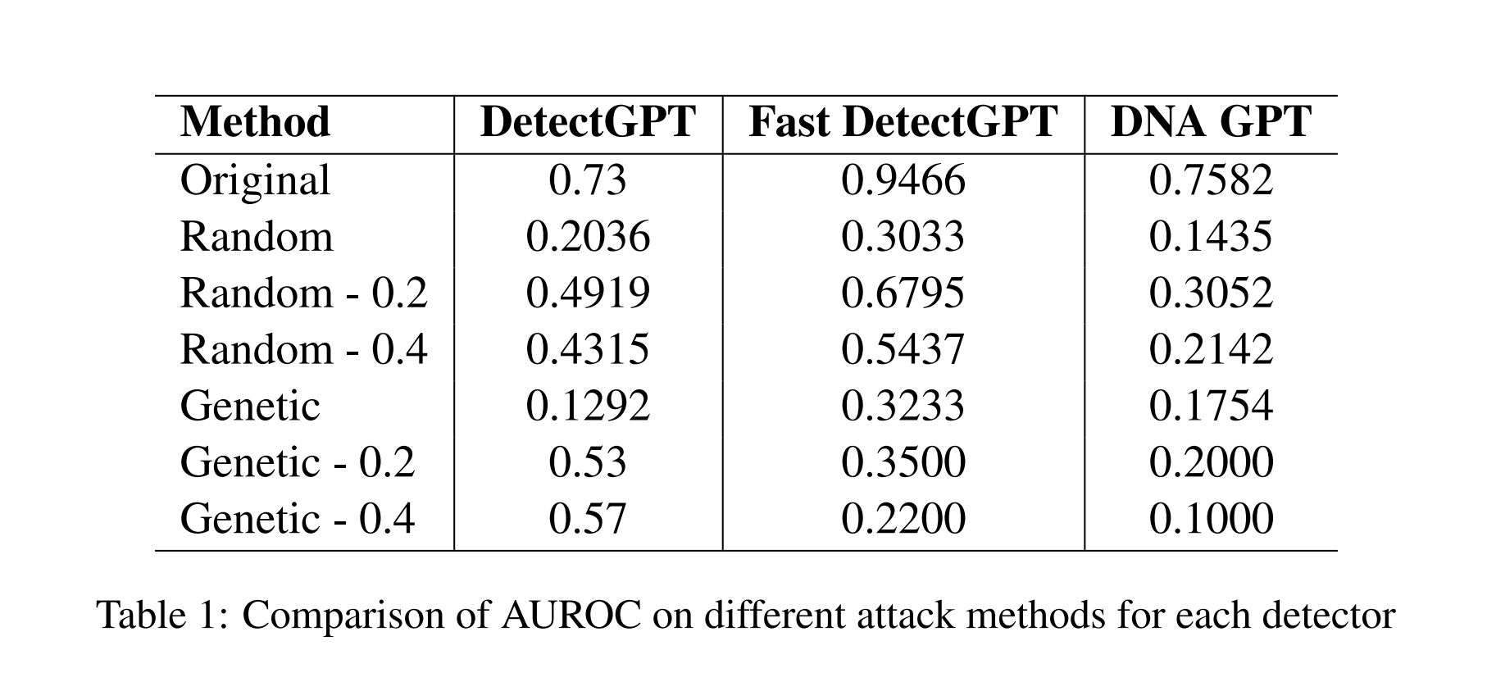
Results

Slide 8
Future Scope
Test for an optimization to beat all detectors using the same attacking method
Determine better techniques to assess quality of text
Test the attack methods on different dataset domains

Slide 9
References
[1] Zhouxing Shi, Yihan Wang, Fan Yin, Xiangning Chen, Kai-Wei Chang, and Cho-Jui Hsieh. 2023. Red teaming language model detectors with language models.
[2] Mitchell, Eric and Lee, Yoonho and Khazatsky, Alexander and Manning, Christopher D. and Finn, Chelsea. DetectGPT: Zero-Shot Machine-Generated Text Detection using Probability Curvature
[3] Guangsheng Bao, Yanbin Zhao, Zhiyang Teng, Linyi Yang, Yue Zhang. Fast-DetectGPT: Efficient Zero-Shot Detection of Machine-Generated Text via Conditional Probability Curvature
[4] Xianjun Yang, Wei Cheng, Yue Wu, Linda Petzold, William Yang Wang, Haifeng Chen. DNA-GPT: Divergent N-Gram Analysis for Training-Free Detection of GPT-Generated Text

